Slide 1


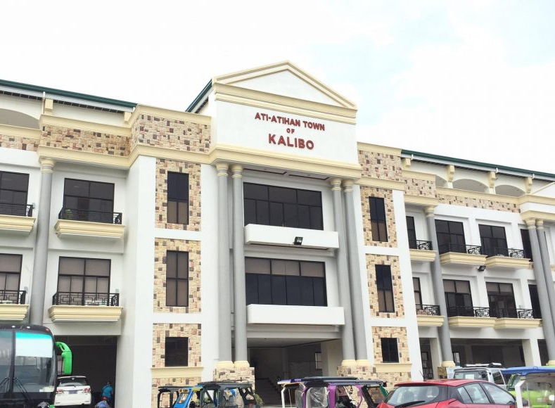
Support for Updating the Land Use Plan and Assessing Climate and Disaster Risks
2nd-Year Internship – BUT Data Science
Leo Jean UNITE
Supervisor: ENGR. Marlo Villanueva (MPDC)
Municipality of Kalibo (OMPDC)
April 28 –July 11, 2025

Slide 2





Structure of the presentation
Context & Objectives
Tools & Methods
Results & Deliverables
Skills & Learning
Conclusion

Slide 3
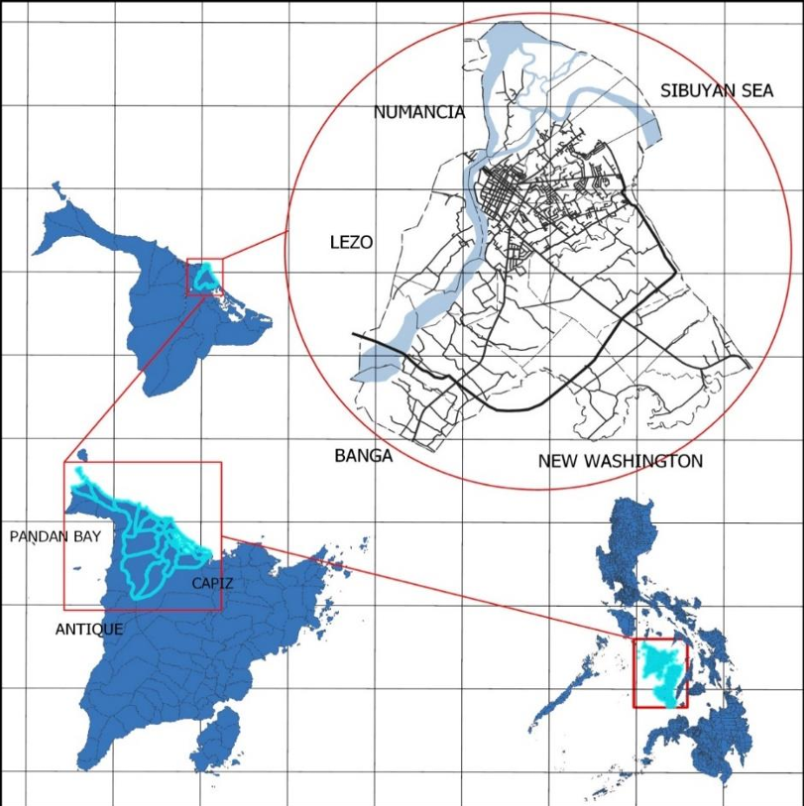


Planning and risk in Kalibo
Capital of Aklan, Panay Island, Philippines
Frequent exposure:
floods typhoons
Development & resilience planning

Slide 4
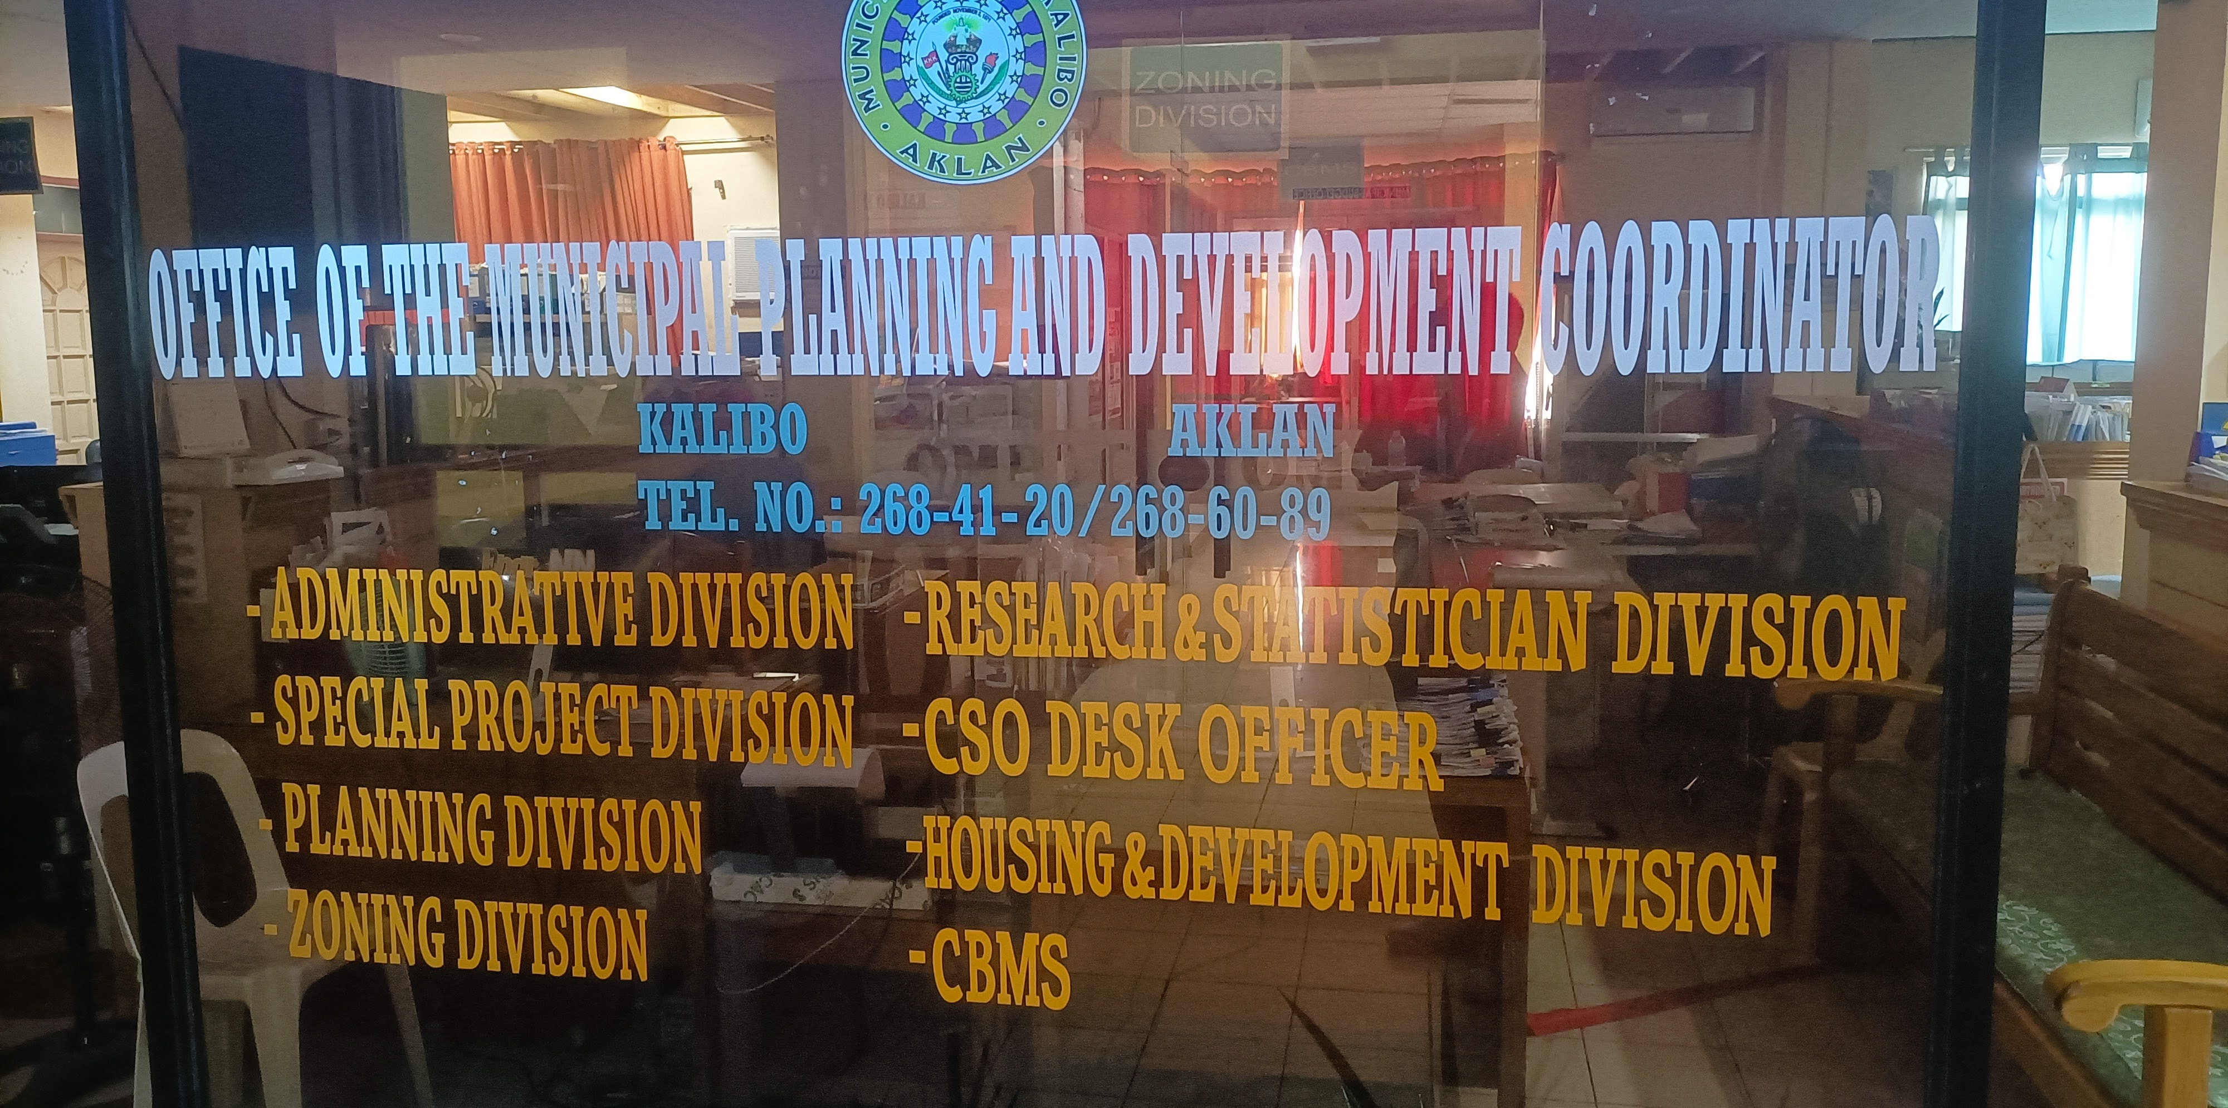
Inside the OMPDC
MPDC office in LGU Kalibo
Research & Statistics Division
Linked to Gov-CDR program

Slide 5
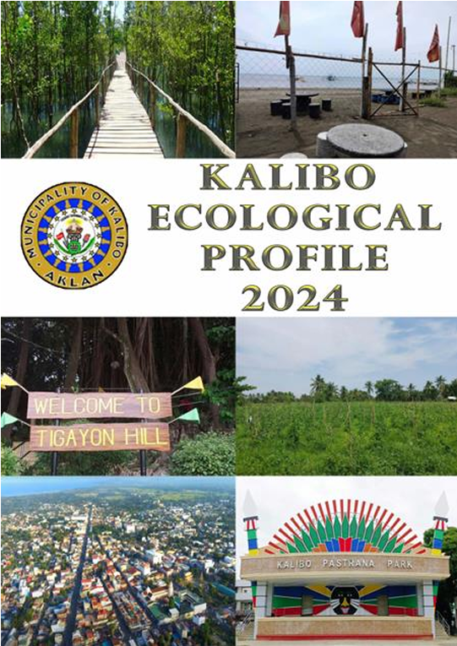

My main missions
Update the Comprehensive Land Use Plan (CLUP)
Analyze CBMS 2022 data
Contribute to Ecological Profile
Thematic planning support
Notes:
CBMS: Community-Based Monitoring System

Slide 6
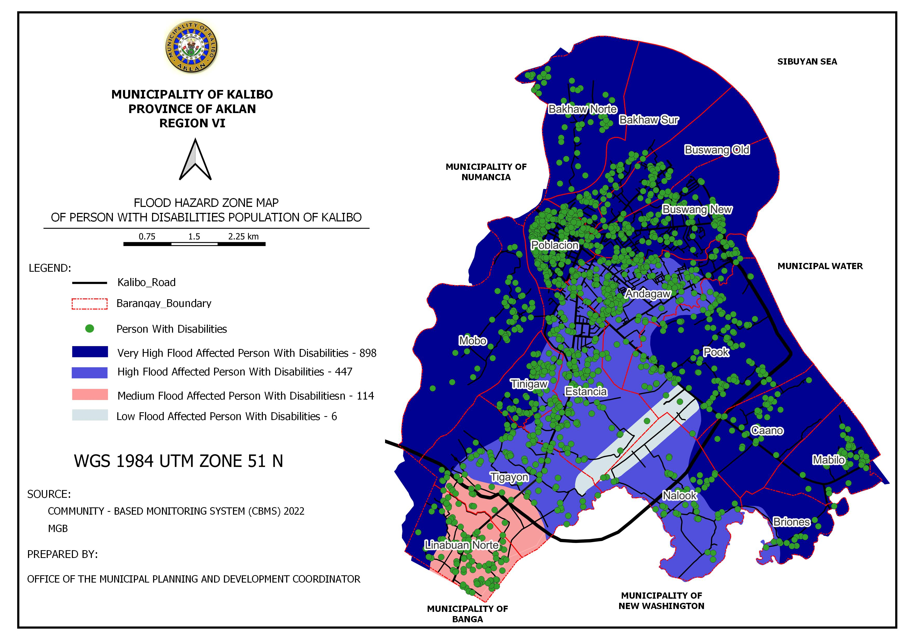
Bringing data into planning
Data not standardized or visualized
Vulnerability not mapped
Hard to support decisions

Slide 7
From raw data to action
• CSPro → extract
• Excel → analyze
• QGIS → map
• PowerPoint → share
Notes:
CSPro: Census and Survey Processing System
GIS: Geographic Information System

Slide 8
Technical environment
CSPro 8.0: census data
Excel: indicators & ratios
QGIS: thematic mapping

Slide 9
Statistical insights
Cross-tables by barangay
Age × risk × vulnerability
Targeted analysis

Slide 10
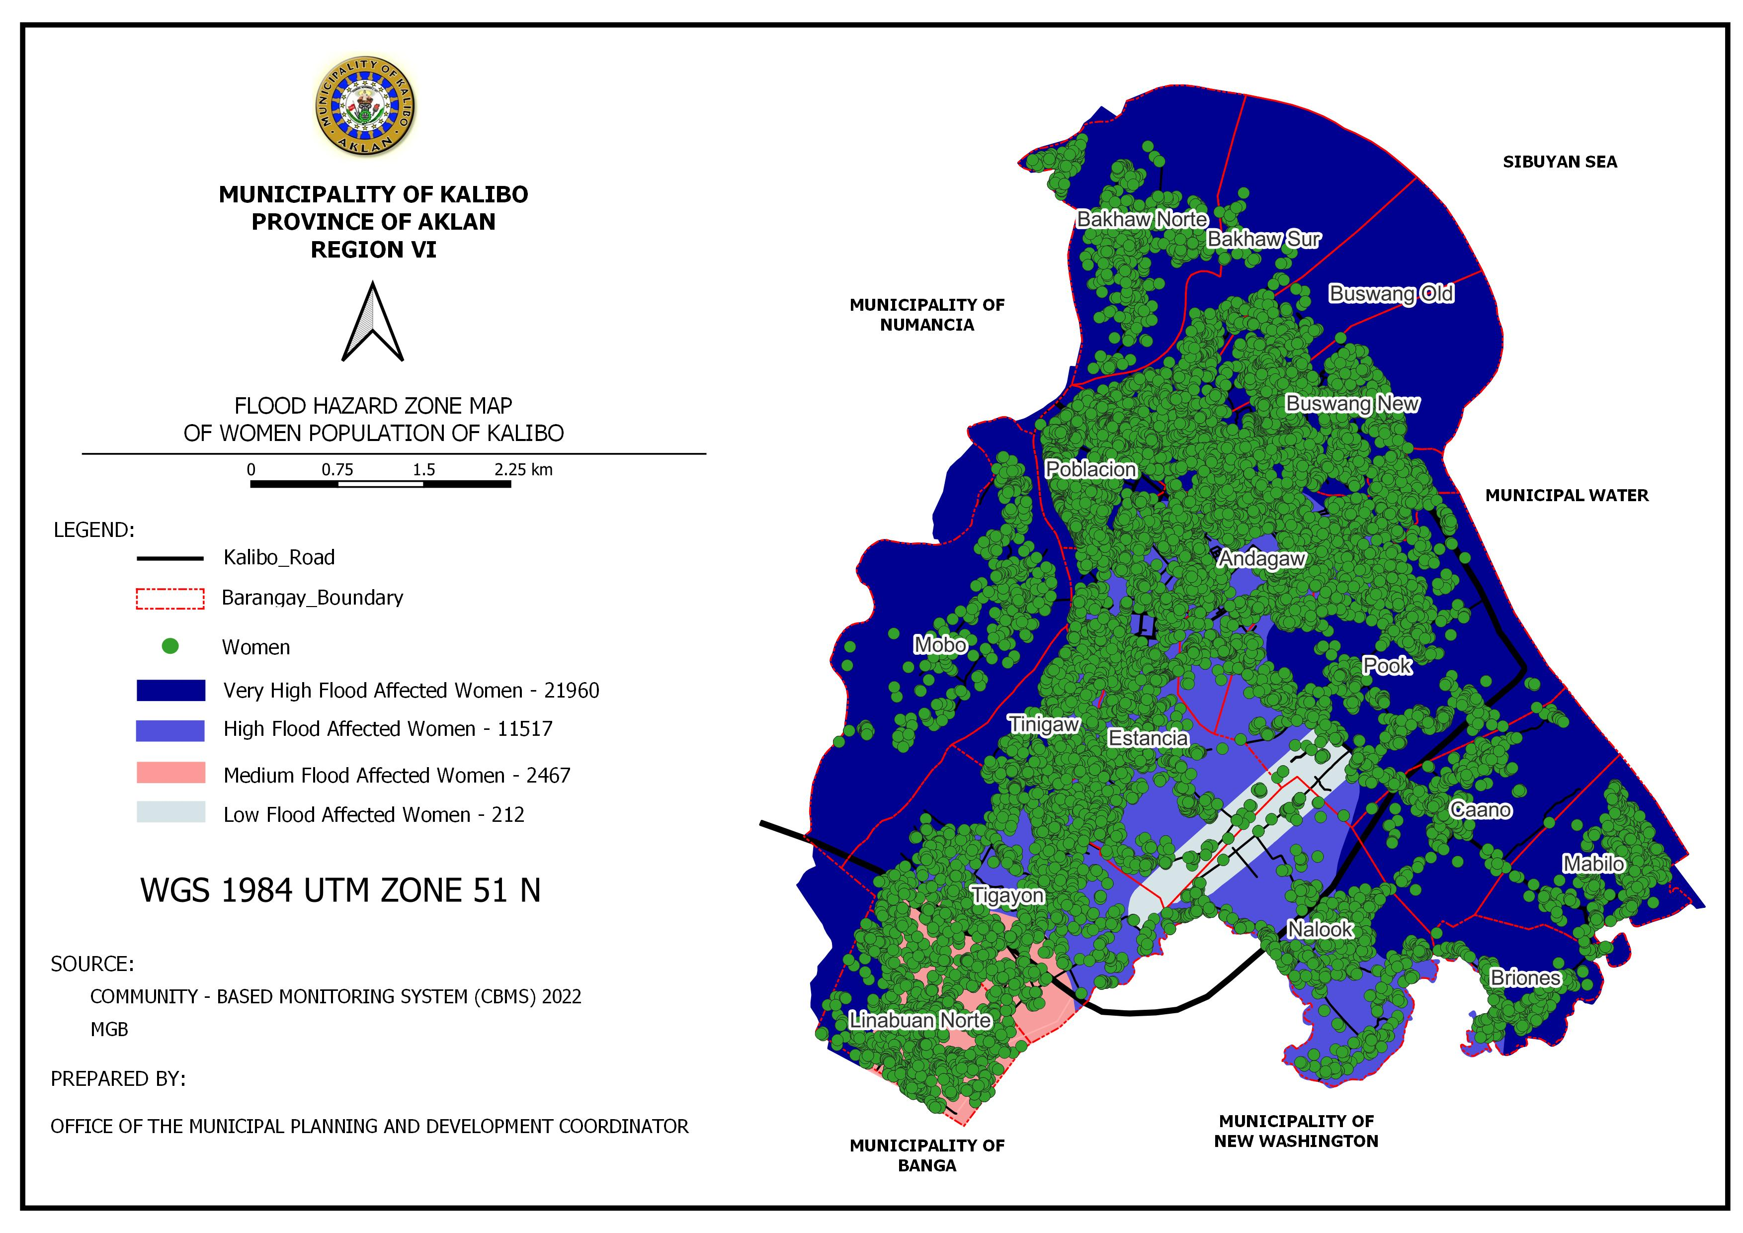
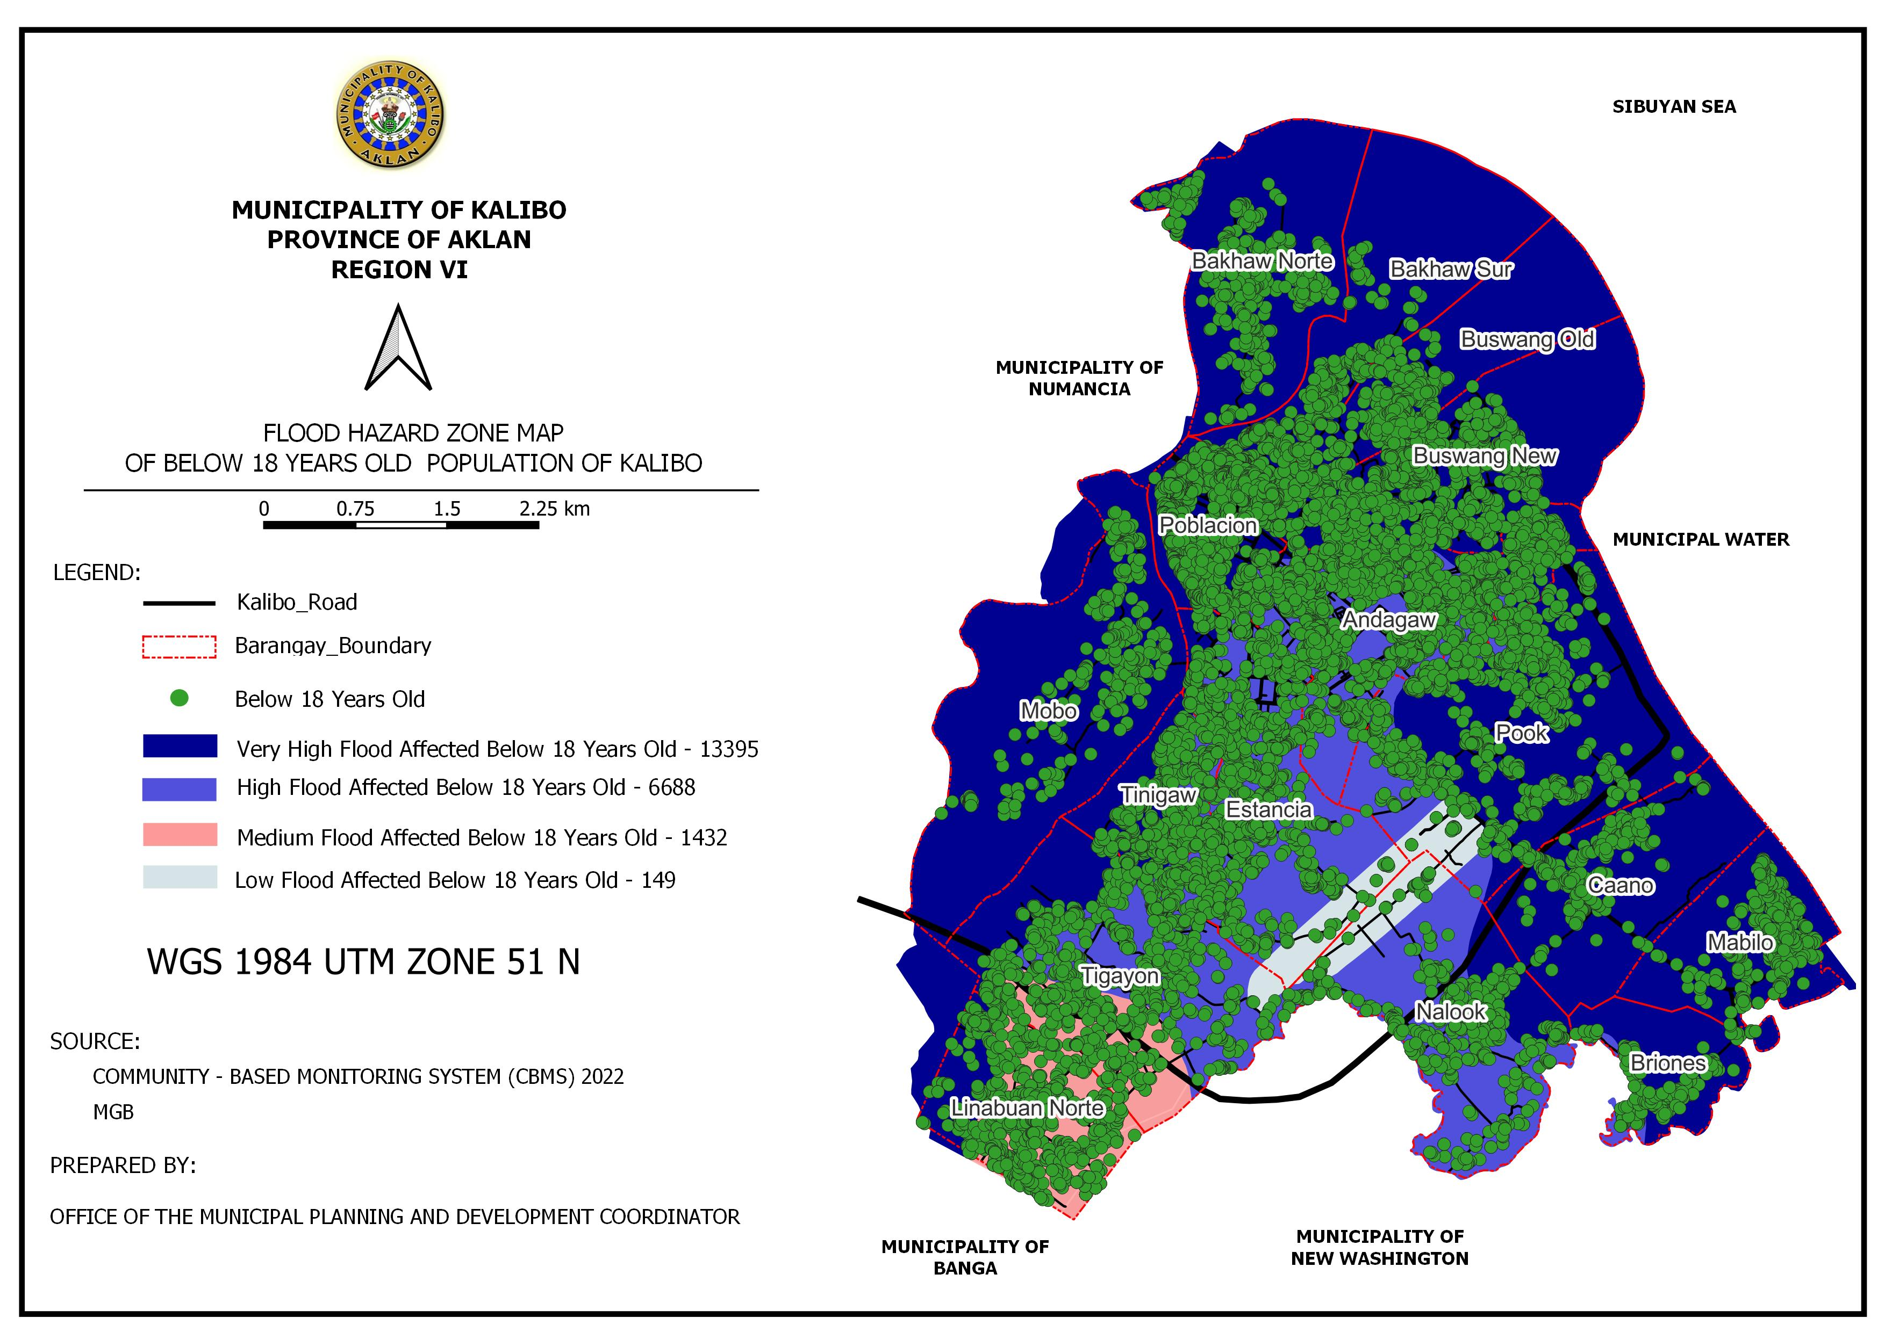
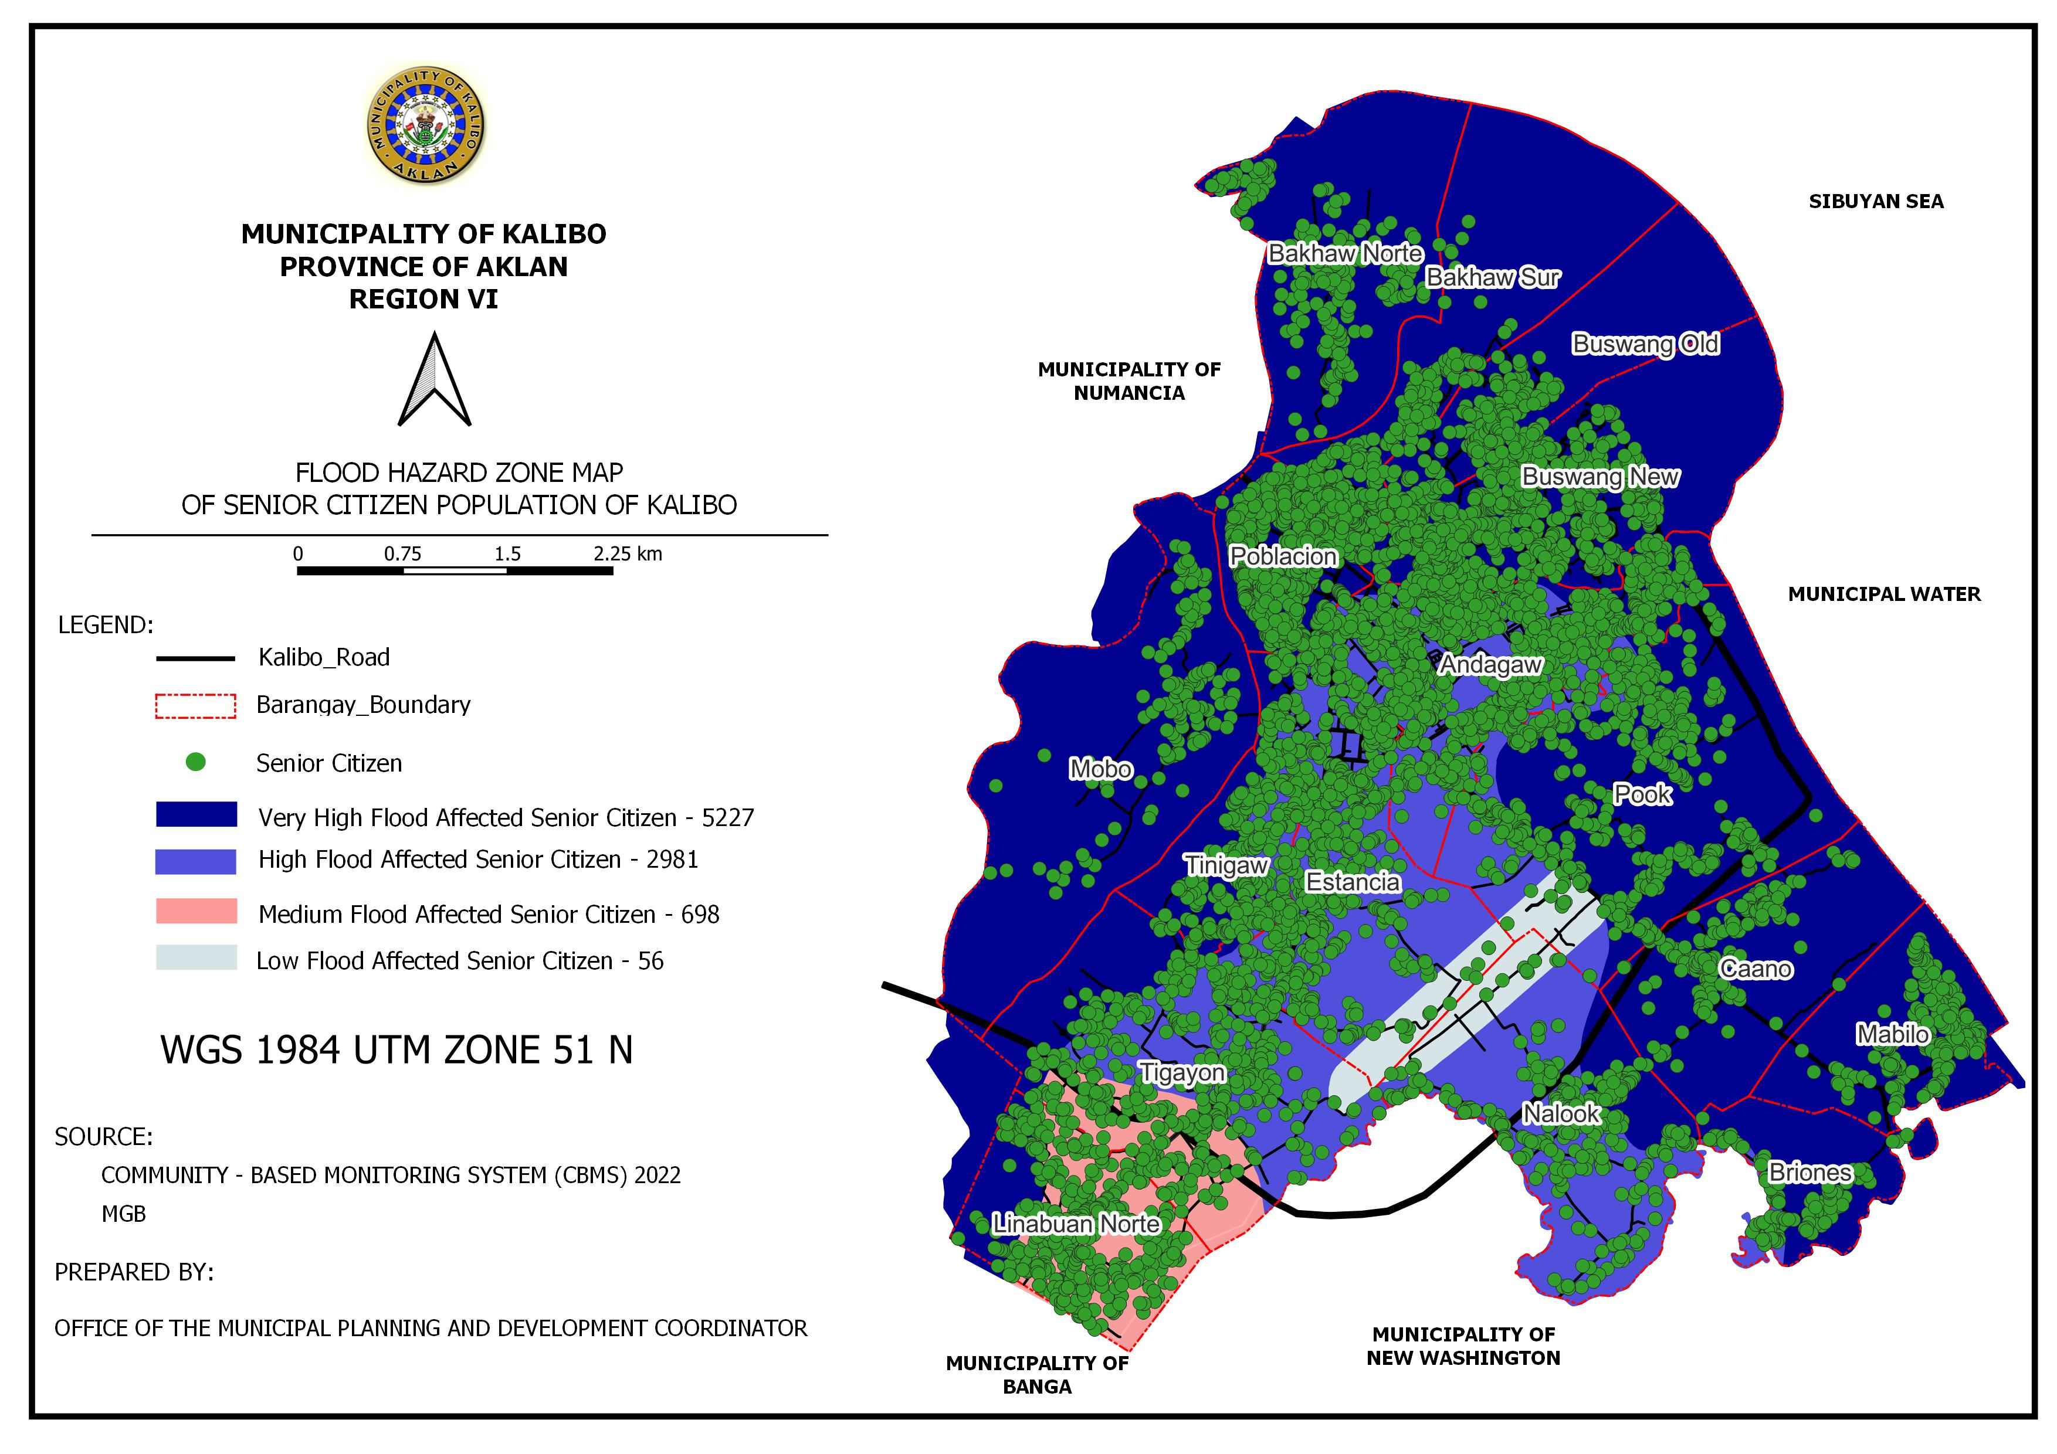
Visualizing risk and inequality
Thematic maps (PWD, seniors, etc.)
Flood zones, service access
Maps for CLUP & profiles (AIP, Ecological)

Slide 11
What I delivered
maps for the CLUP
Indicator dashboard
Presentation at Sectoral Meeting
Edits to 2024 Economic Profile

Slide 12
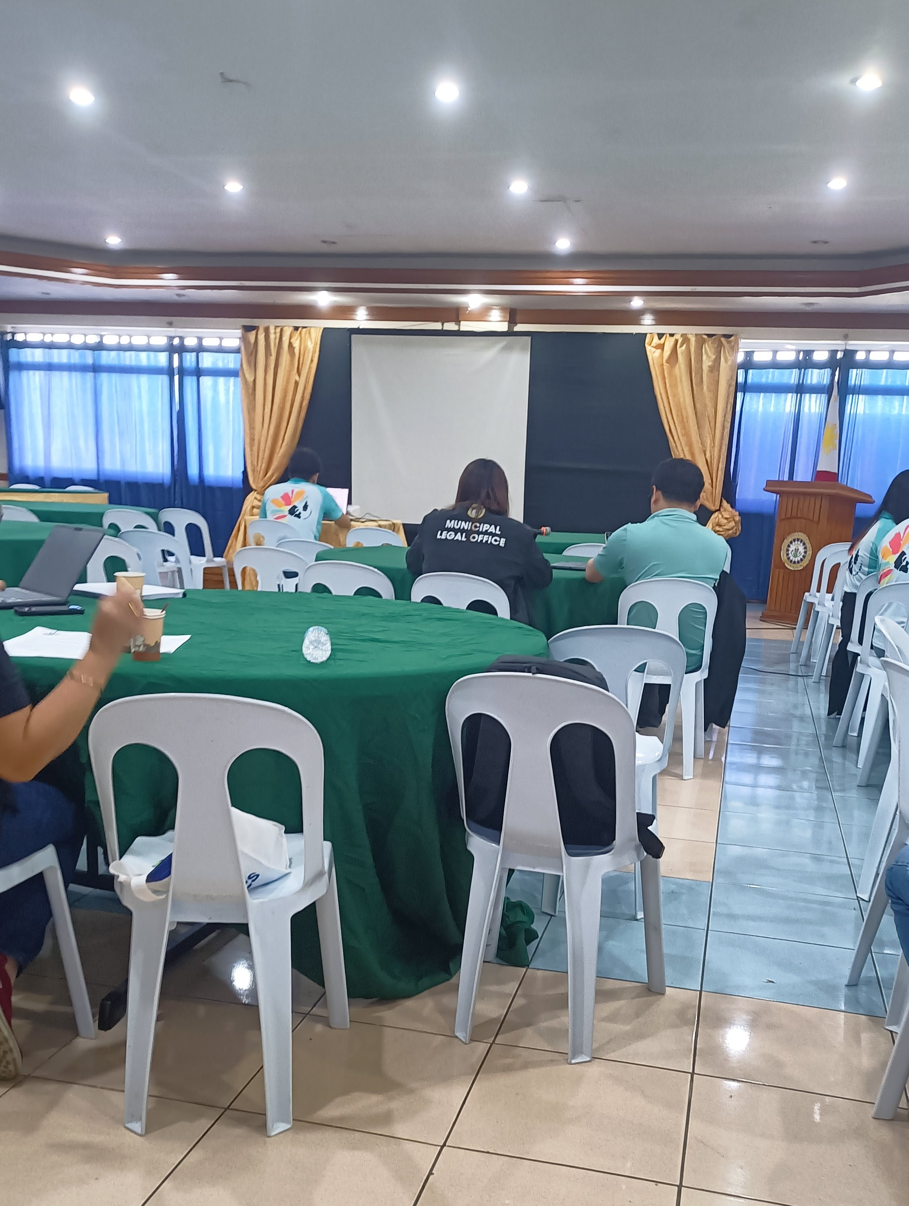
Working across departments
Meetings with Local Dep’s
Feedback and validation
Stakeholder coordination

Slide 13




Key learning from VCOD track
Data processing pipeline
Statistical analysis
Map-based communication
Decision-support visuals

Slide 14
Final steps before July 11
Final map refinements
Profile update
Technical note and briefing

Slide 15
A meaningful and applied experience
Data into real decisions
Developed technical and soft skills
Public-interest analytics

